Slide 1
Best location of new Indian restaurant Chapati On! in Manchester, England

Slide 2
Background
£1m has been secured from three investors who wish to invest in a new Indian restaurant, named Chapati On!, to be located somewhere in Manchester, England.

Slide 3
Goal
The investors wish to understand the Manchester area, specifically to inform them of the best location for Chapati On!

Slide 4
Restaurant data
Foursquare.com hosts venue data for restaurants and other eating establishments, as well as other attractions and venues in a given area.
Foursquare has 128 restaurants in the Manchester area, of which 14 are Indian restaurants.

Slide 5
Data sources
www.wikipedia.org/wiki/M_postcode_area for postcode data in the Manchester area.
www.freemaptools.com/download-uk-postcode-lat-lng.htm for latitude and longitude data
www.foursquare.com for venue data

Slide 6
Data cleaning
Drop all postcodes which are not physical areas eg postbox numbers.
Drop duplicate rows of the same post code.
Drop rows of data not relating to Manchester.
Clean any hidden code (eg '/n') to enable data merges.
Drop latitude and longitude data for irrelevant postcodes in the UK.

Slide 7
Methodology
Initial merge
After data cleaning 36 postcode areas remained.
Use latitude and longitude data for the 36 postcodes to obtain venue data from Foursquare.com.

Slide 8
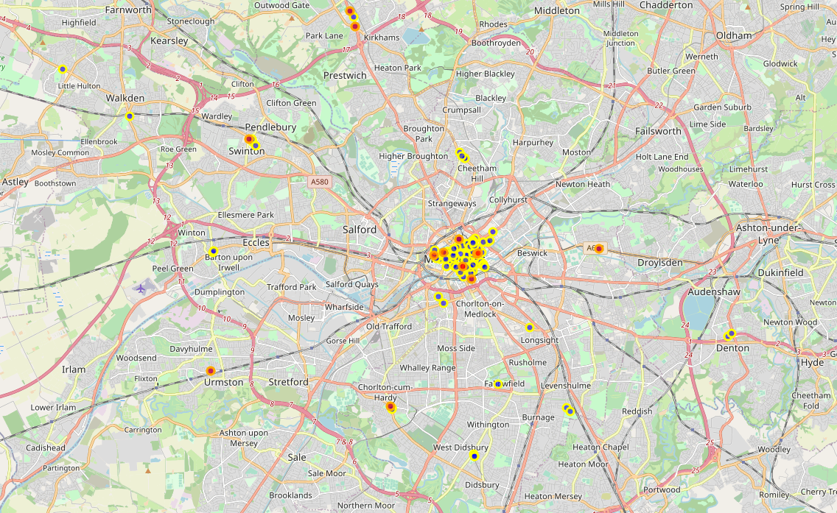
Restaurant data
Foursquare lists 128 restaurants in Manchester, including 14 Indian restaurants.
Indian restaurants marked in red/orange

Slide 9
Areas with a high density of restaurants
Postcode | Venue count
M2 | 32
M1 | 29
M3 | 22
M4 | 10
M21 | 5
M27 | 4
M1, M2, M3 and M4 are the postcodes with the highest number of restaurants.

Slide 10
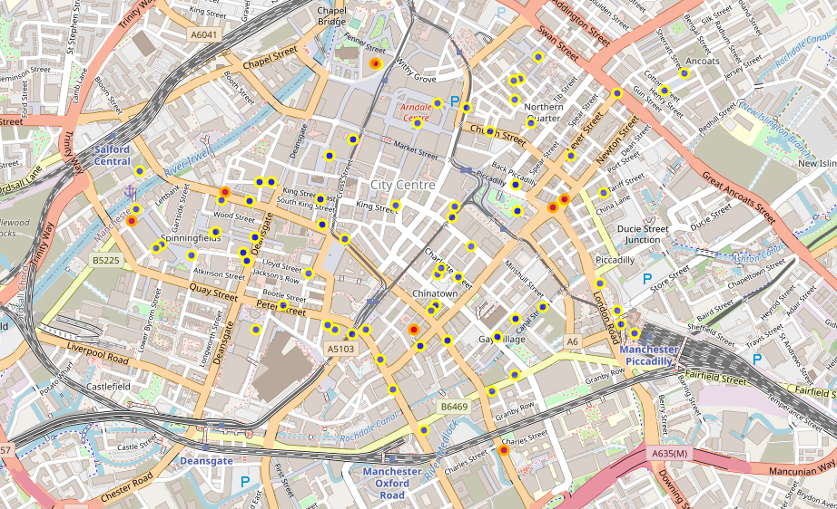
Explore M1, M2, M3 and M4
There are 93 restaurants in these four areas in total, including 8 Indian restaurants
Indian restaurants marked in red/orange

Slide 11
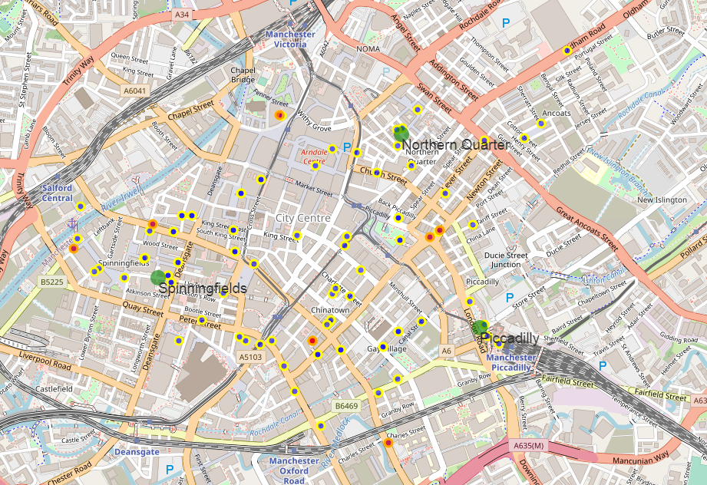
Results
There are three areas which have other restaurants nearby but no Indian restaurants.
Northern Quarter
Spinningfields
Piccadilly

Slide 12
Other venues in Northern Quarter, Spinningfields and Piccadilly
160 other non-eating venues.
Use onehot encoding for most common types of venues
Area | 1st | 2nd | 3rd | 4th | 5th
Northern Quarter | Gay Bar | Hotel | Bar | Beer Bar | Pub
Spinningfields | Bar | Pub | Bookstore | Record Shop | Art Store
Piccadilly | Hotel | Bar | Plaza | Pub | Grocery Store

Slide 13
Findings
Piccadilly has the most drinking establishments (ie bar or pub) nearby compared to the other two areas.
Piccadilly is also close to the train station, which increases accessibility to the area.

Slide 14
Recommendation
Manchester Piccadilly appears to offer the best opportunity for the investors of Chapati On! as the area has a high number of restaurants, but no other Indian restaurants. Its proximity to the train station increases its accessibility.

